Slide 1
A Client Commercial Analysis Report
Data Analyst - Reza Muzhaffar Zidan

Slide 2
Introduction
This report is dedicated for A Client. This document contains commercial analysis report that hopefully can help A Client for performing data-driven decision making for the future. This report are recorded from 01 January 2021 to 30 December 2021. In general, this report will contain:
Commercial Overview
Time Series Analysis
Location Based Analysis

Slide 3
Commercial Overview

Slide 4
Sales Overview
394355 Items Sold 200591 Orders
Item Name | Total
Product 4 | 62,879
Product 8 | 23,663
Product 15 | 21,460
Product 19 | 20,750
Product 10 | 17,978
Product 14 | 17,266
Product 27 | 15,495
Product 9 | 15,353
Product 11 | 12,890
Product 100 | 11,858

Slide 5
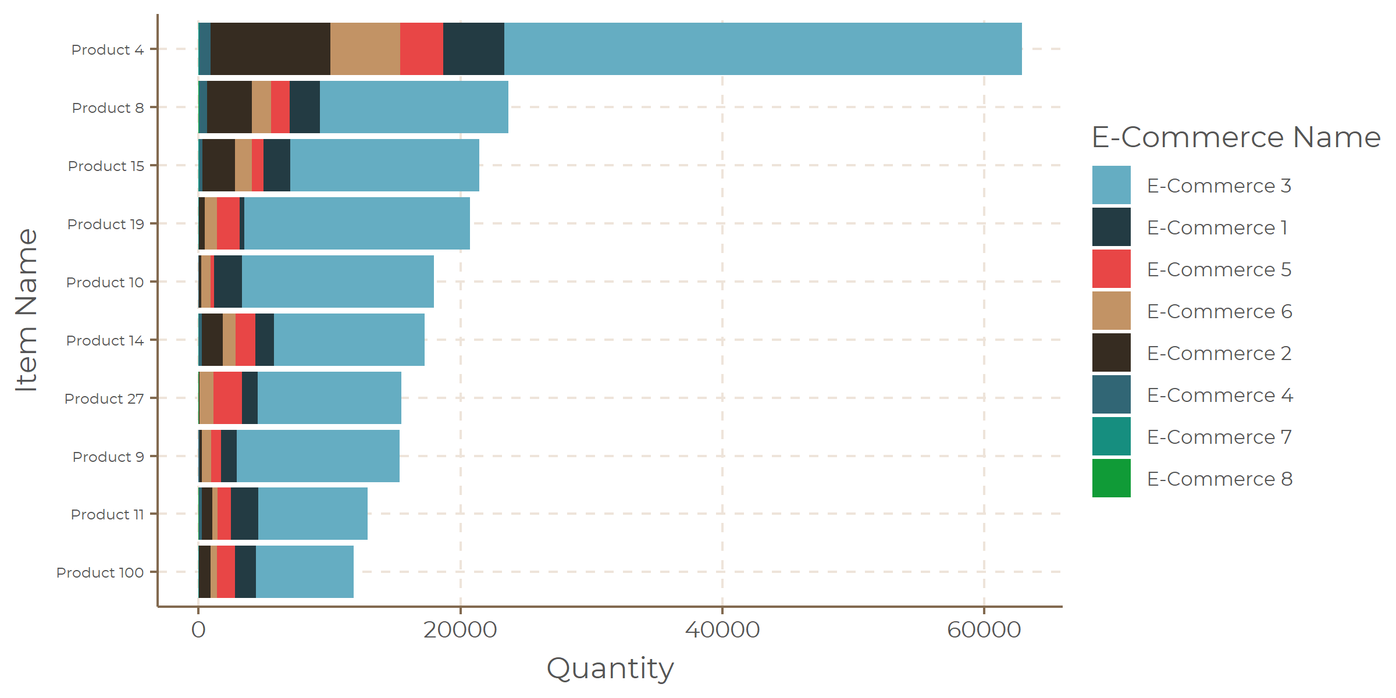
Top 10 Items Sold

Slide 6
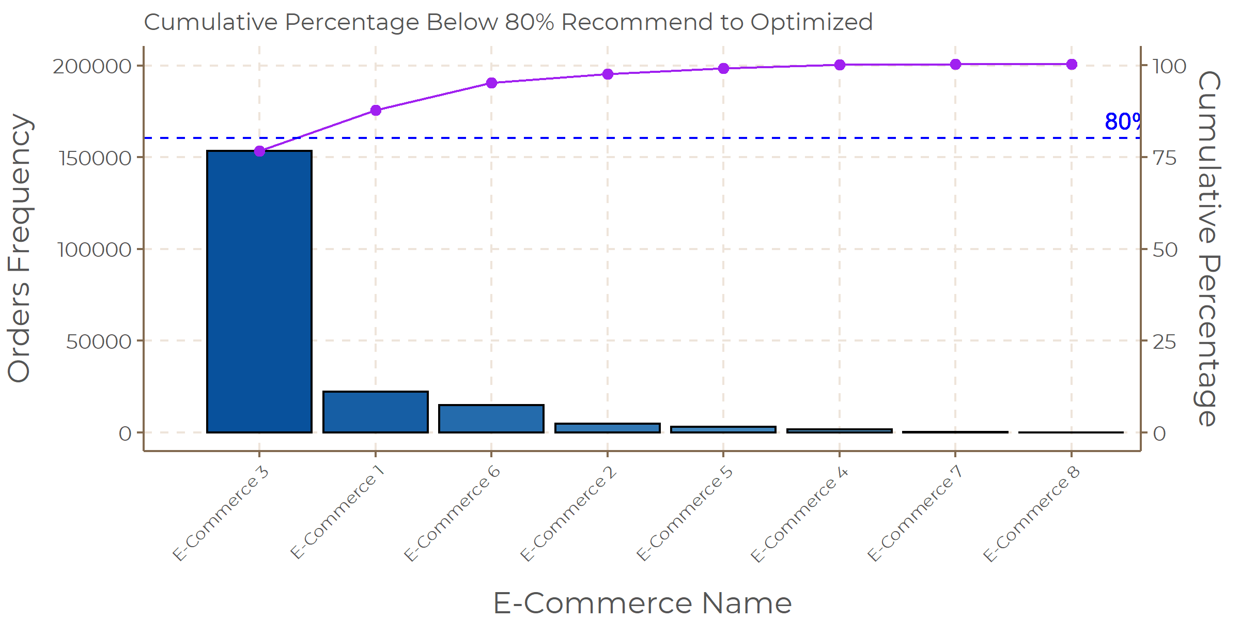
E-Commerce Contribution with Pareto Principle

Slide 7
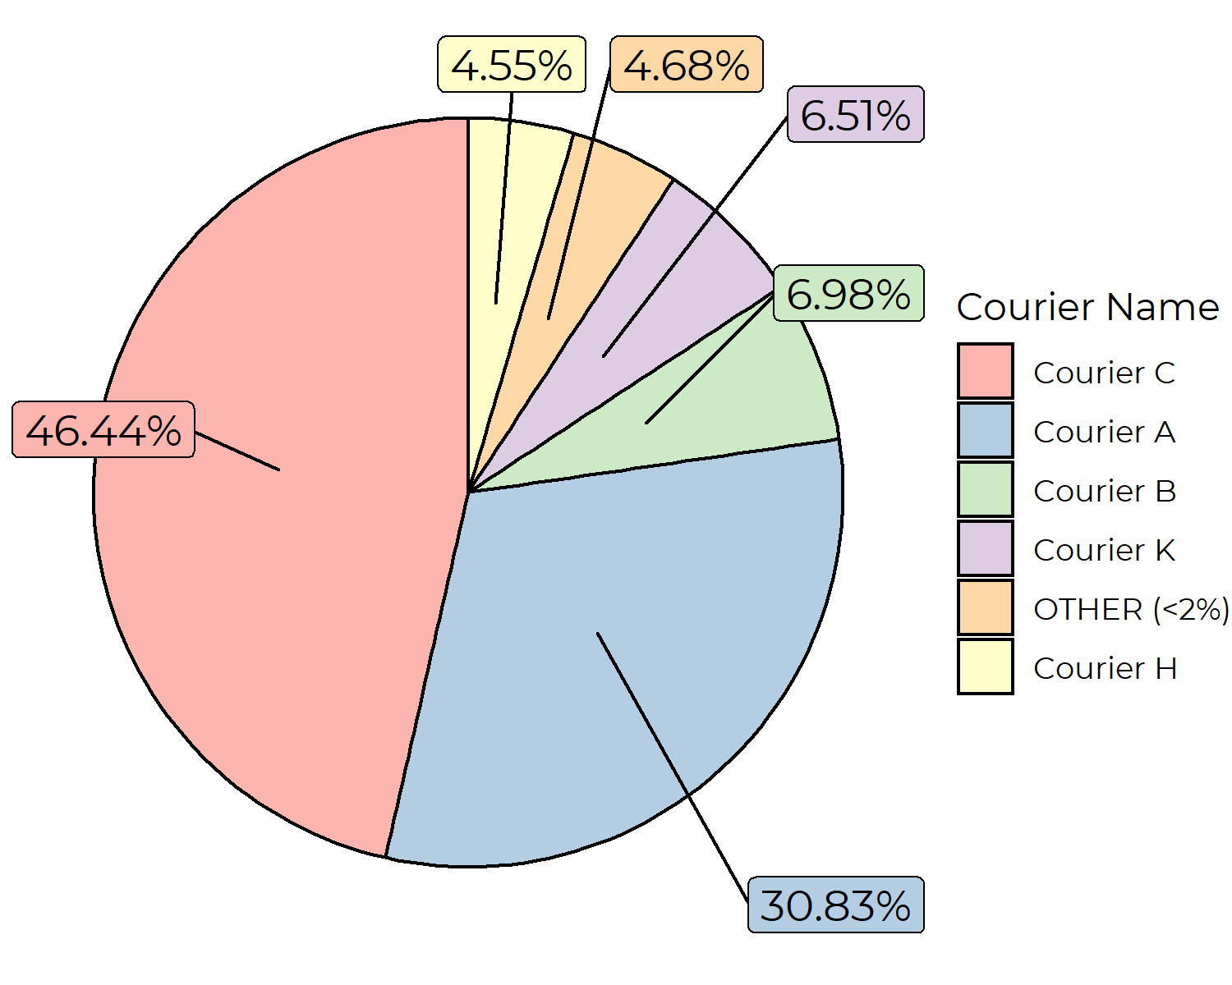
Courier Contribution

Slide 8
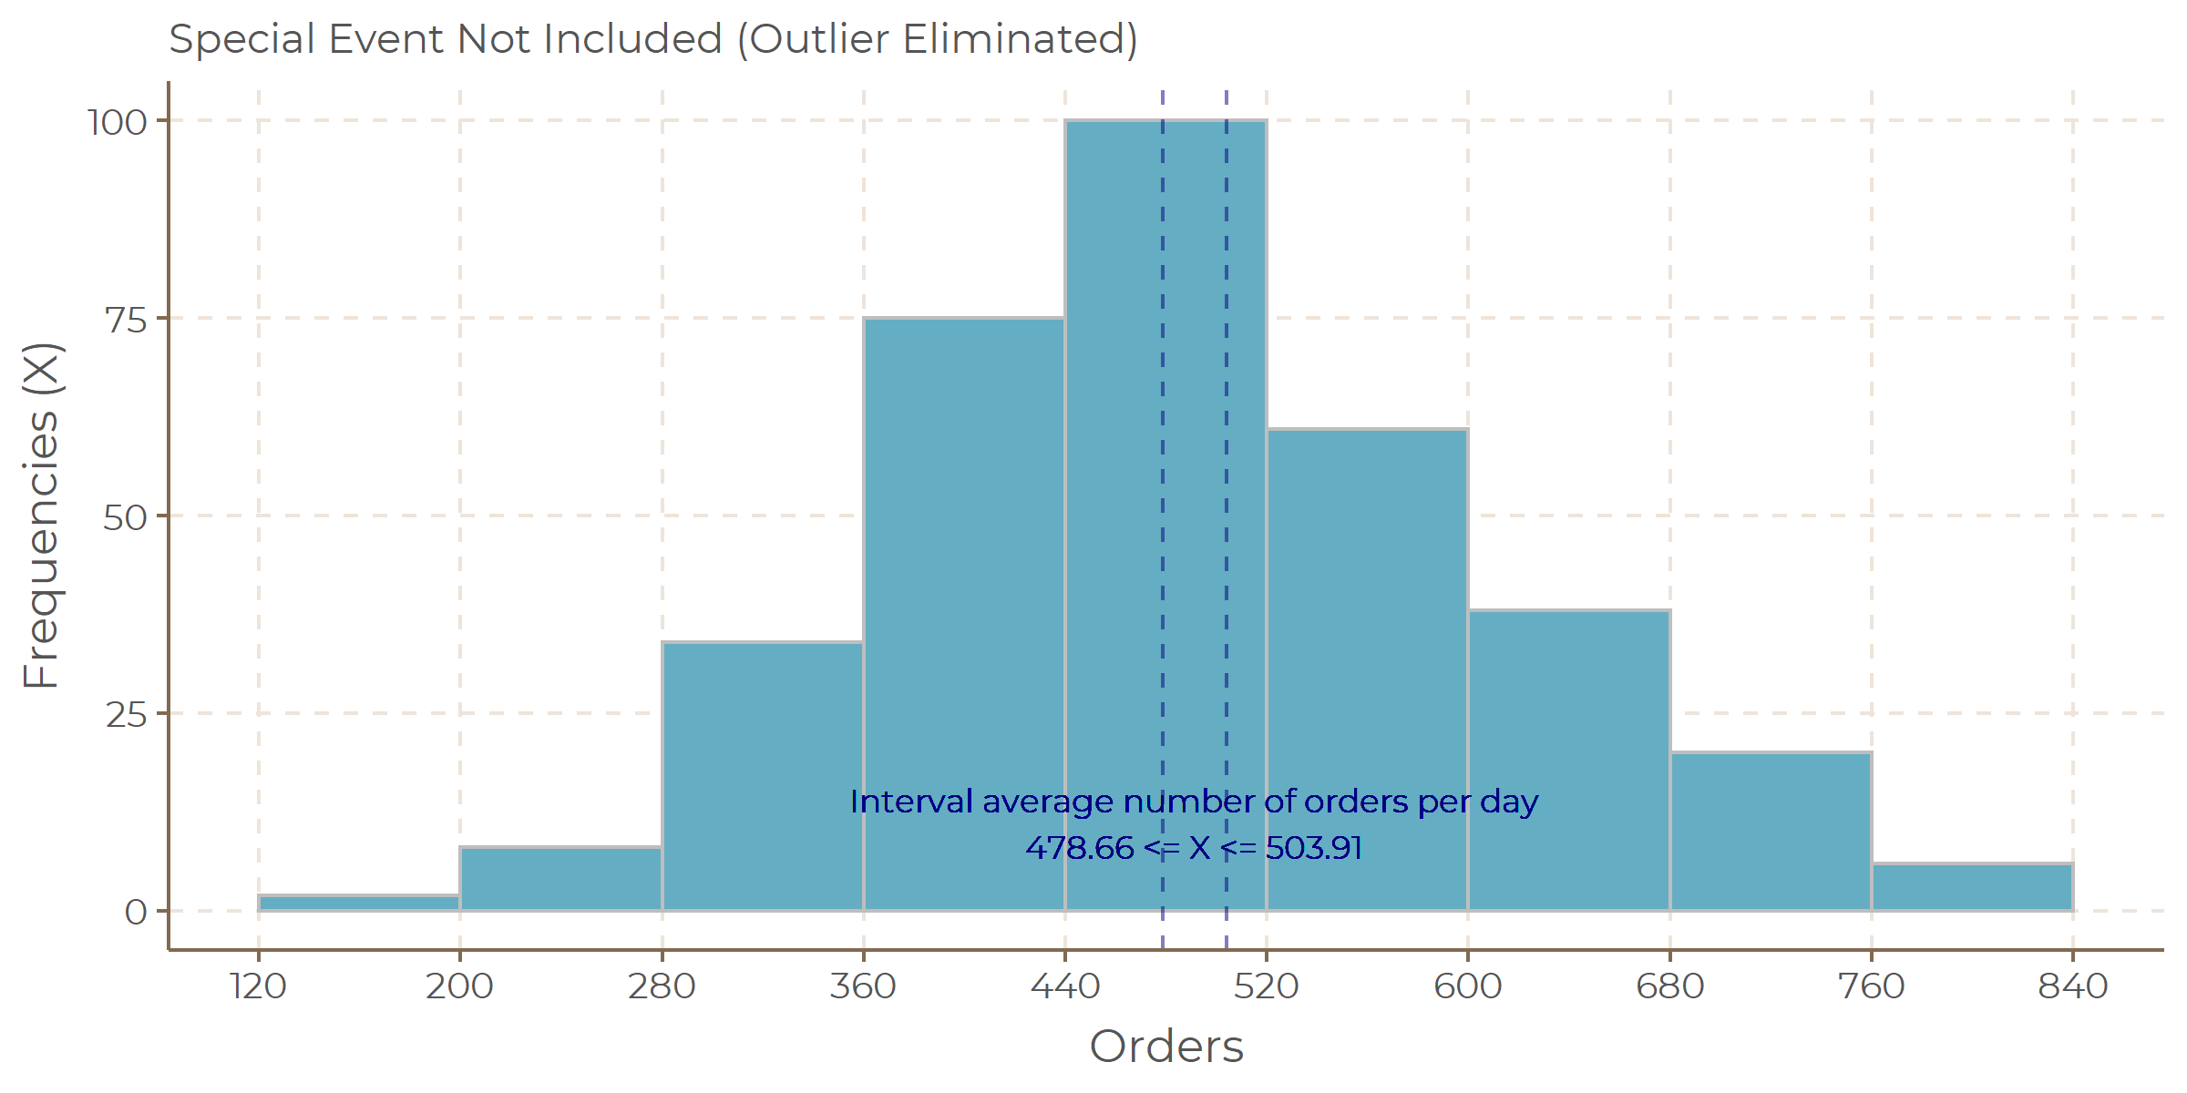
Orders per Day Distribution

Slide 9
Time Series Analysis

Slide 10
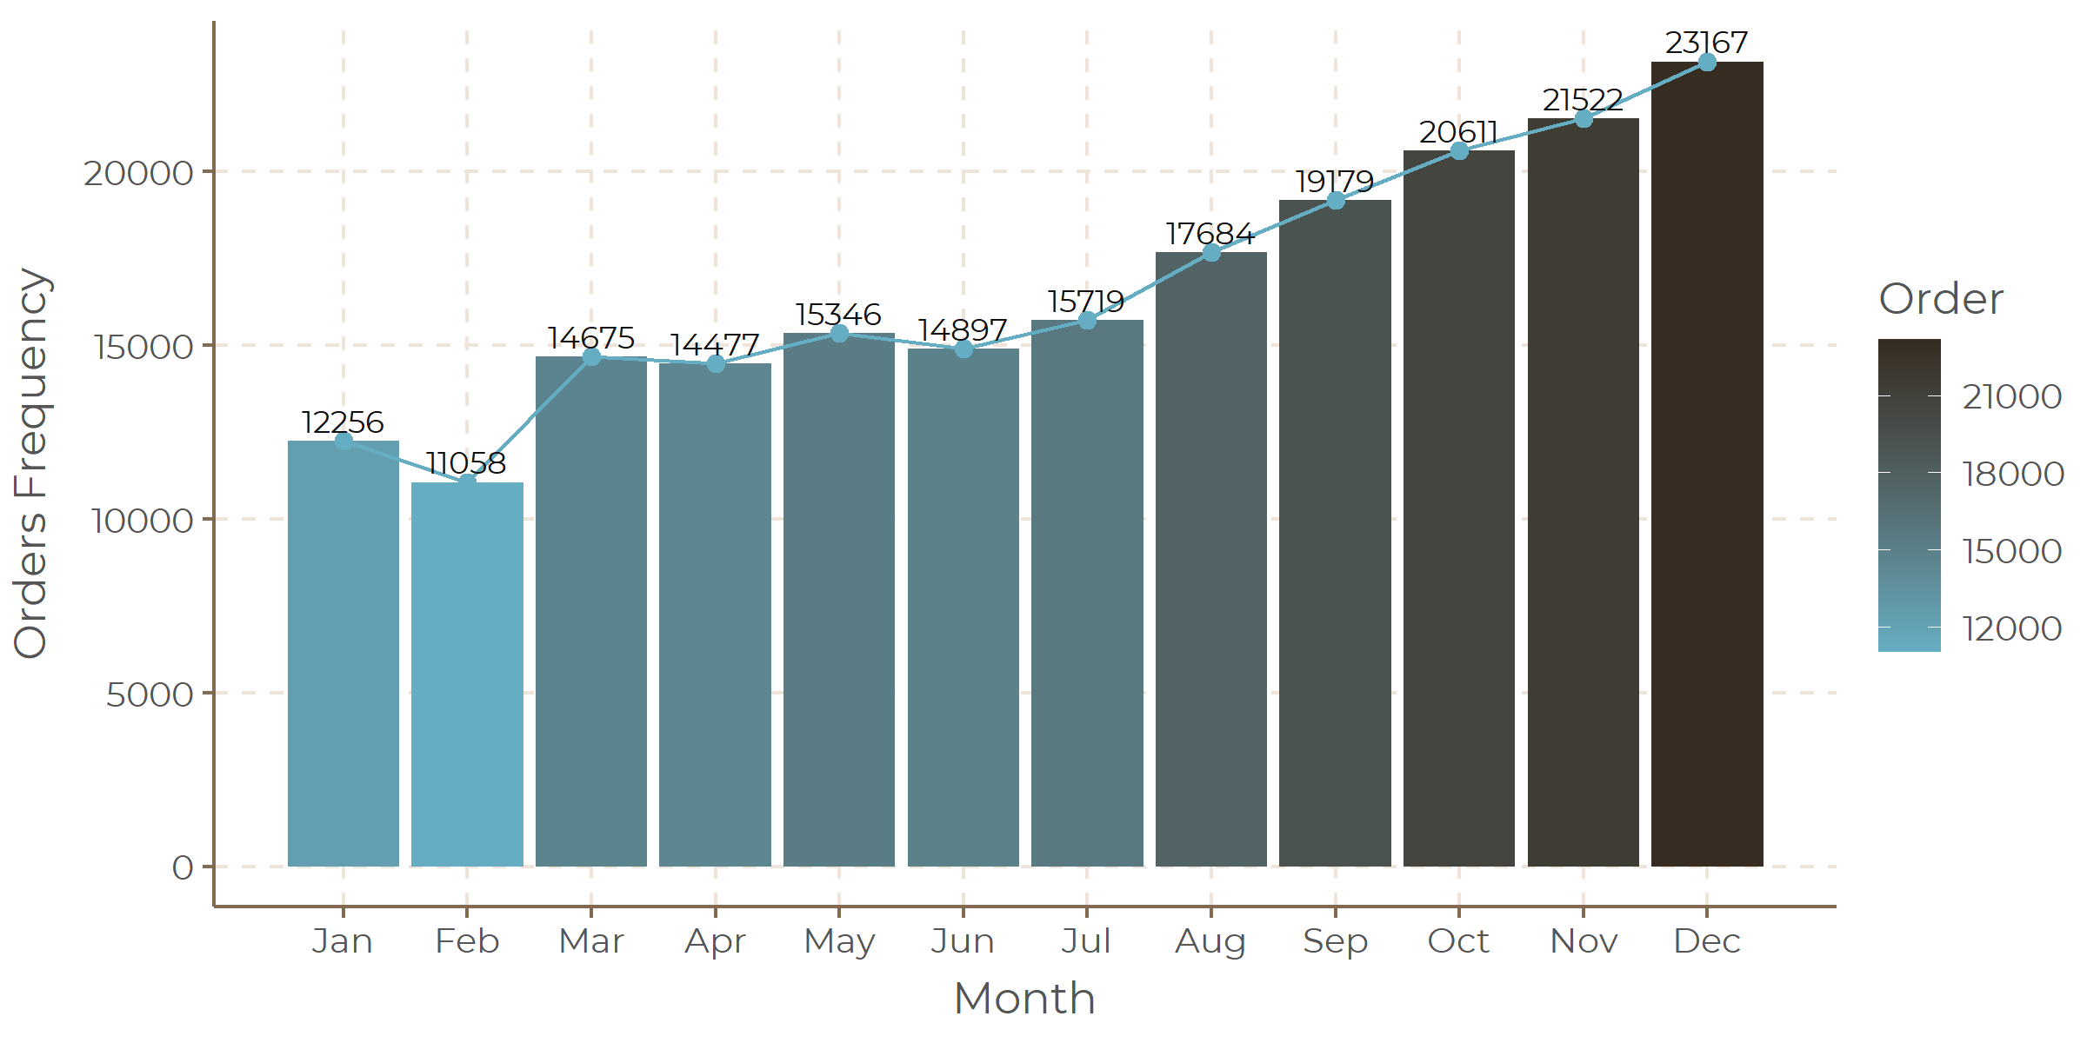
Order Growth

Slide 11
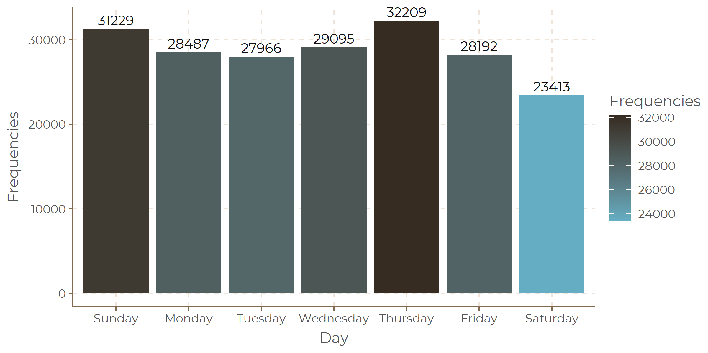
Number of Order by Day

Slide 12
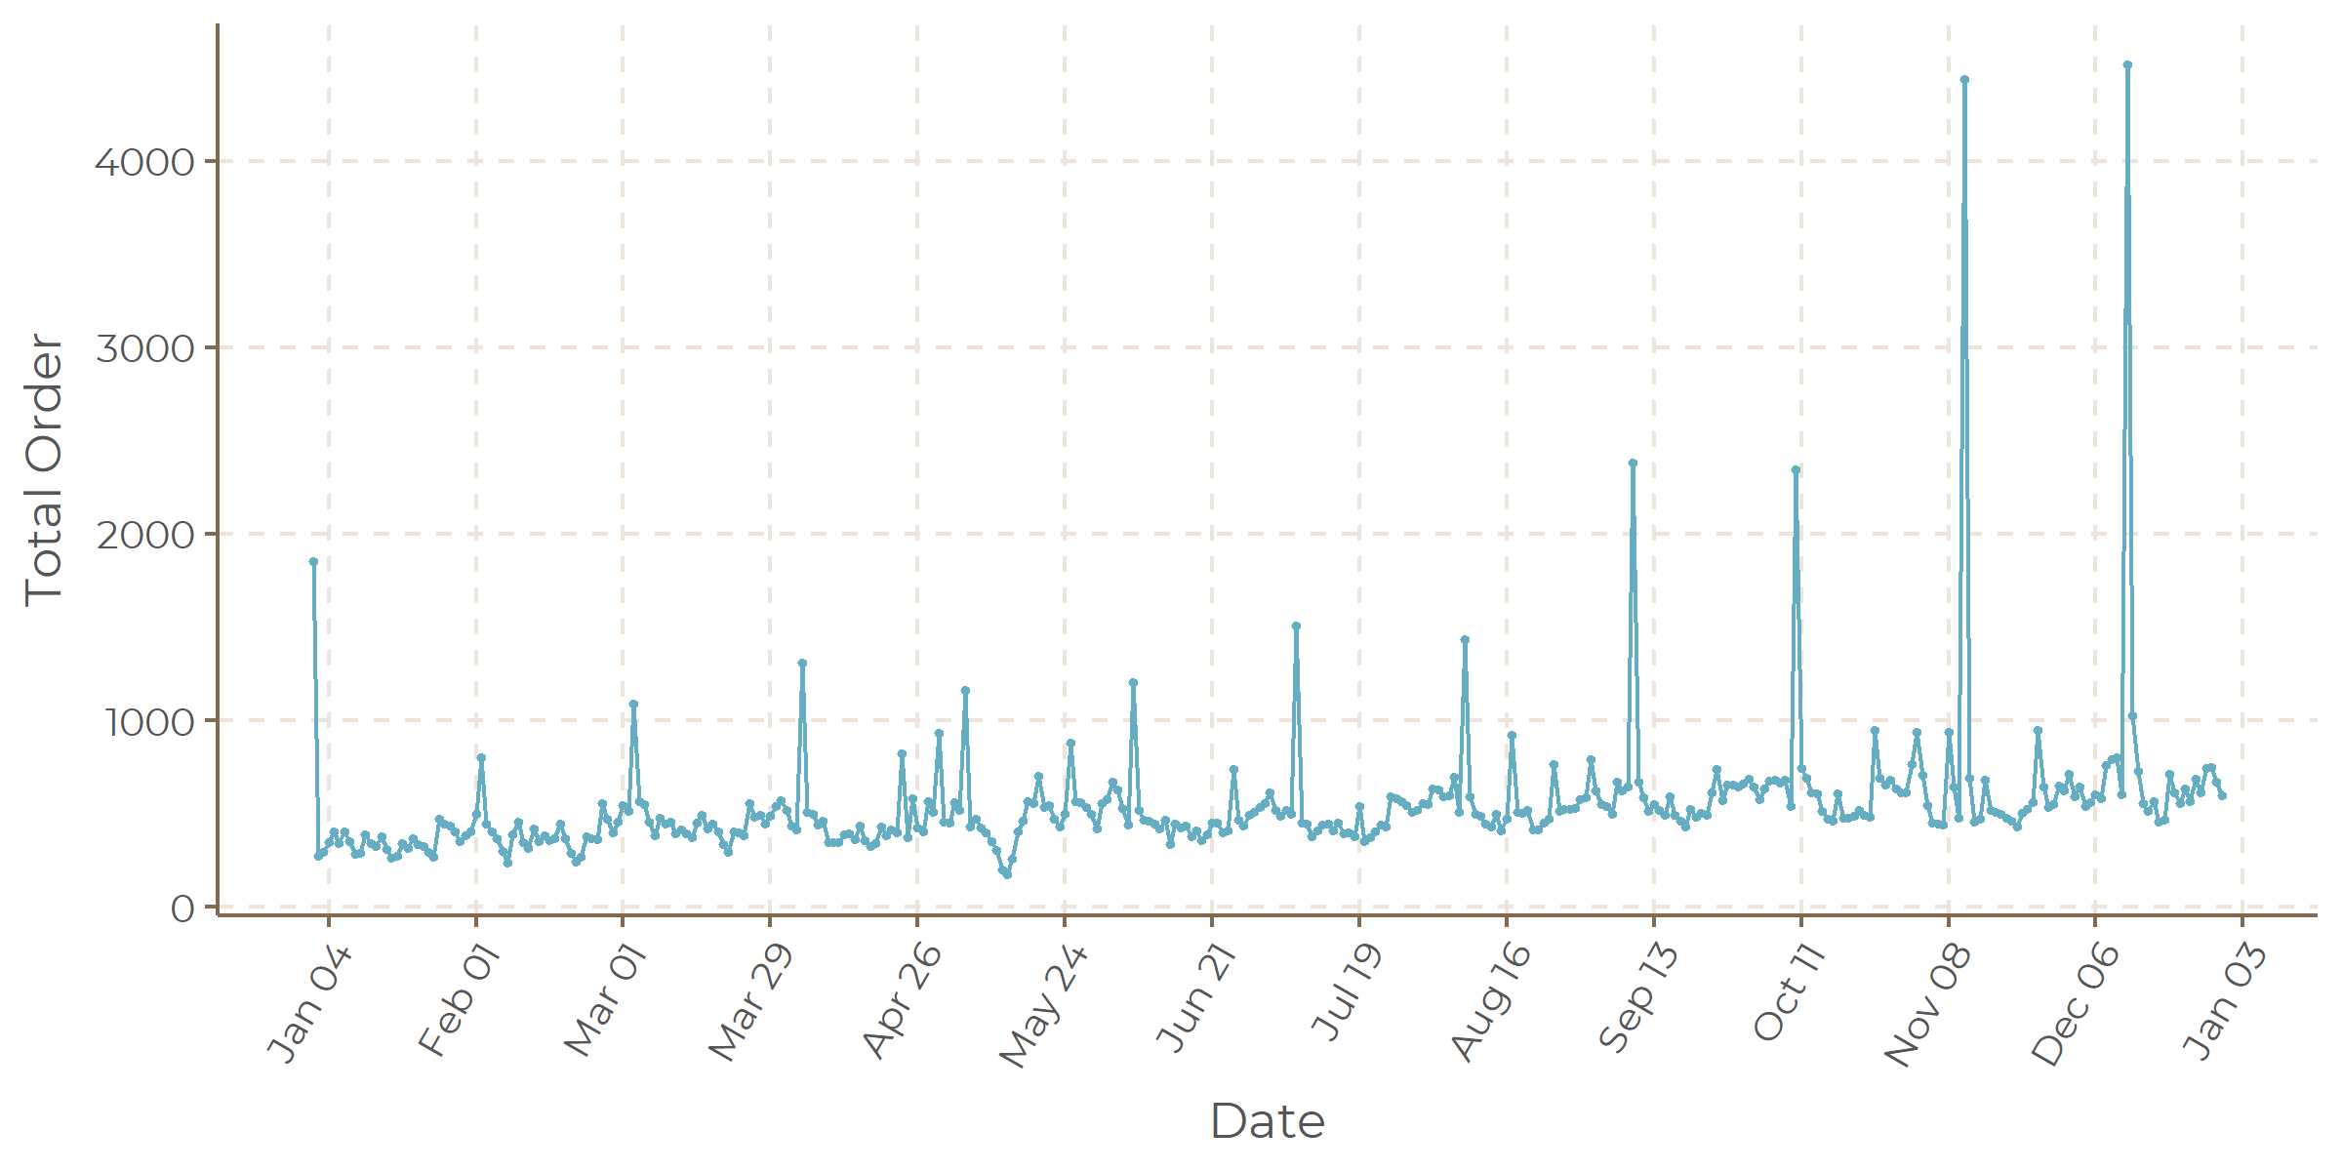
Daily Number of Orders

Slide 13
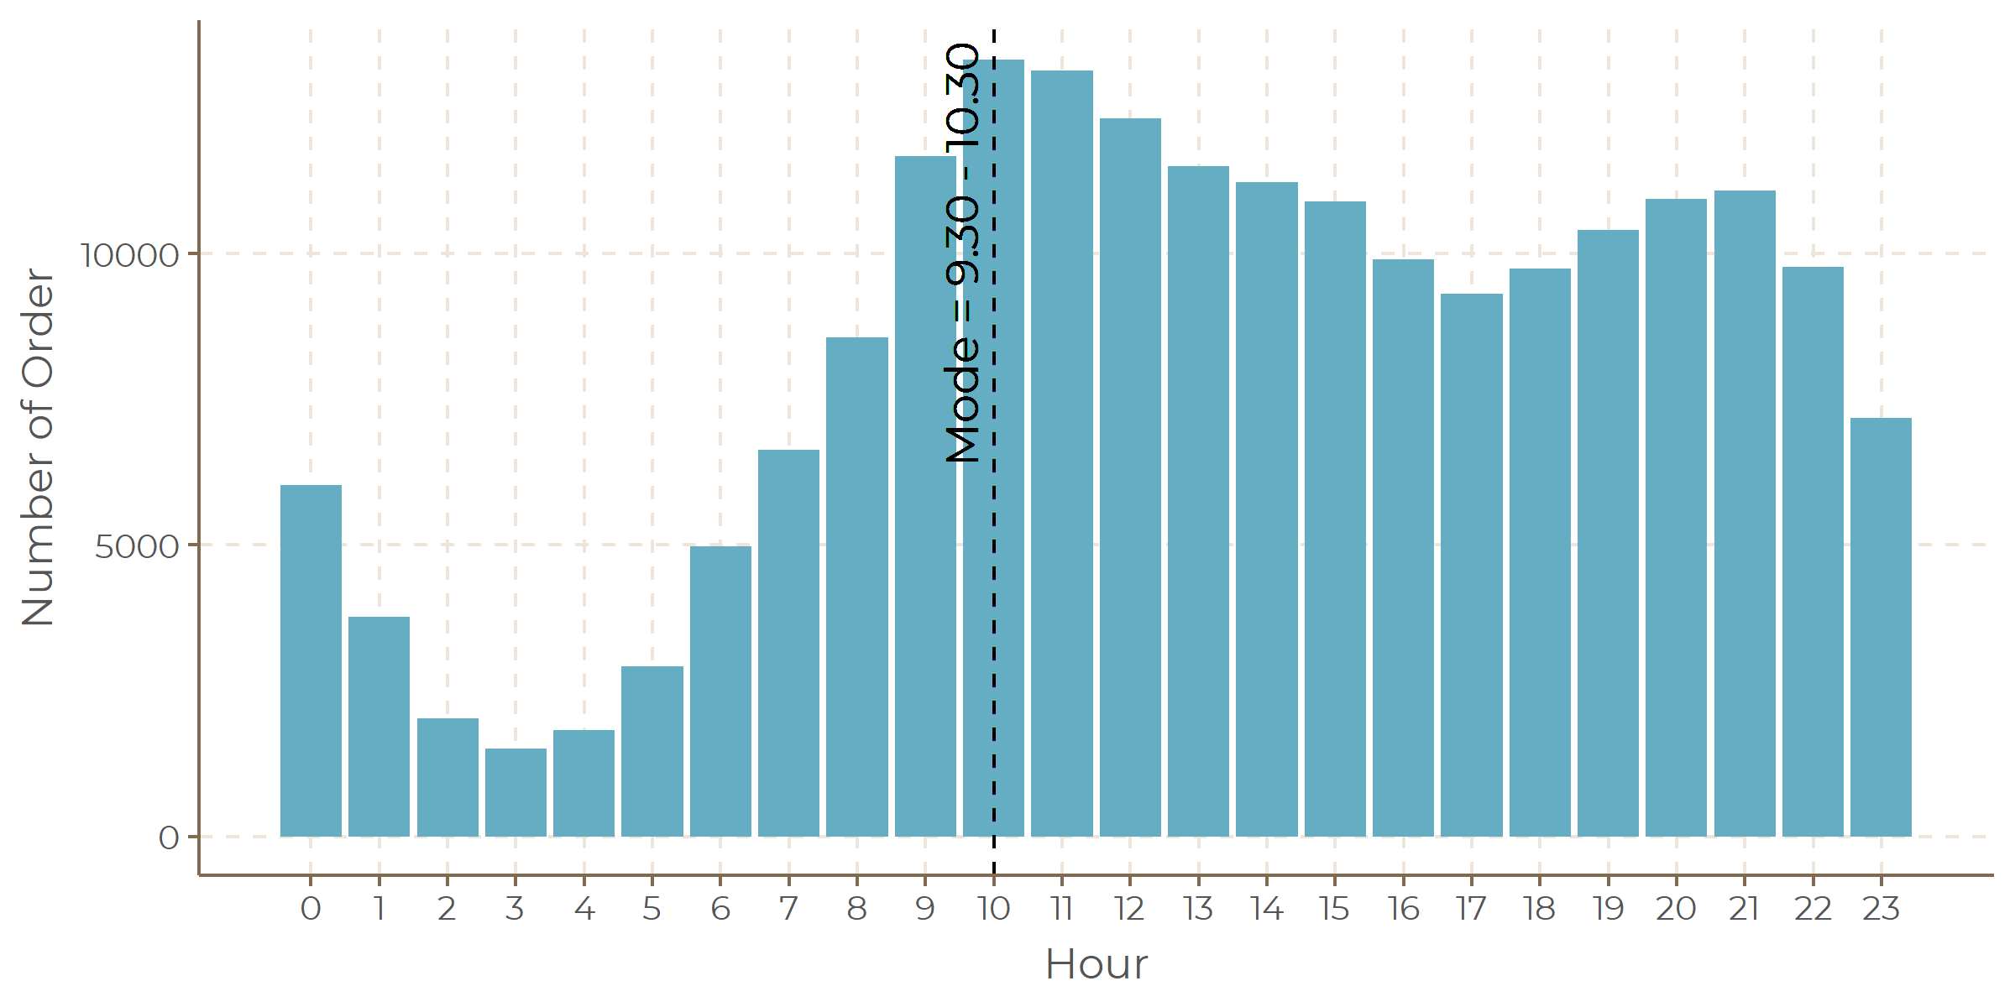
Number of Order by Hour

Slide 14
Location Based Analysis

Slide 15
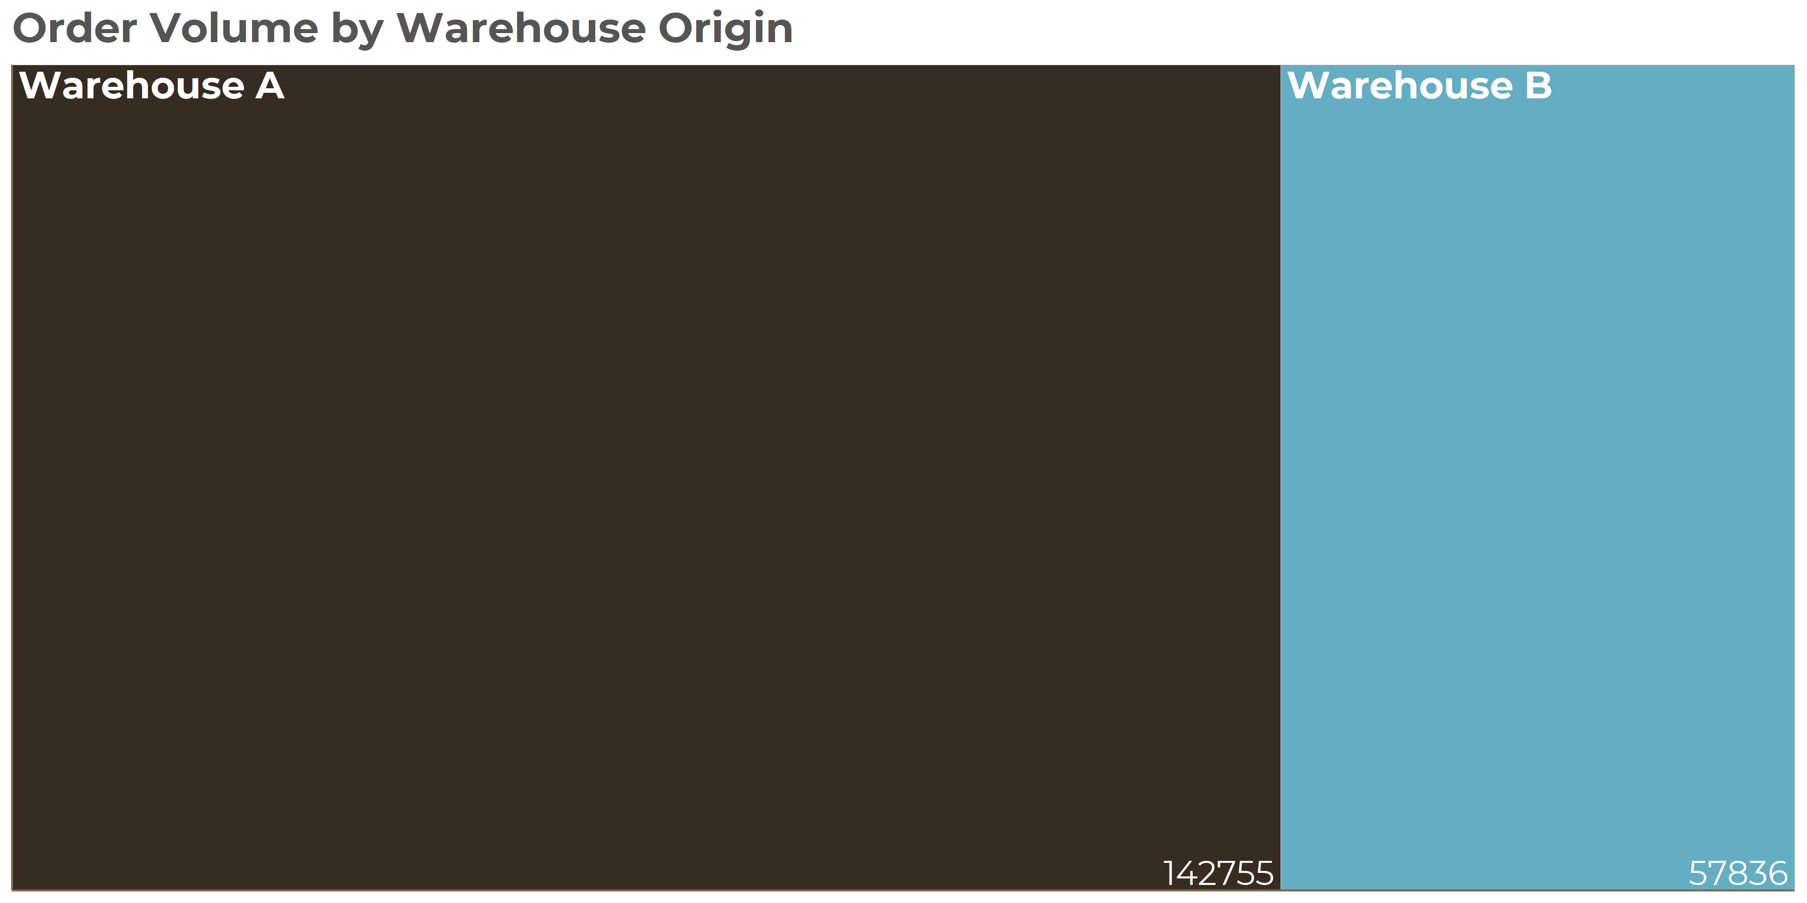
Warehouse Contribution

Slide 16
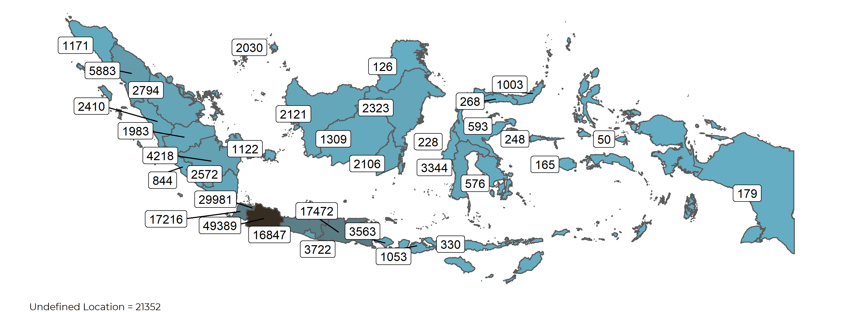
Orders Mapping

Slide 17
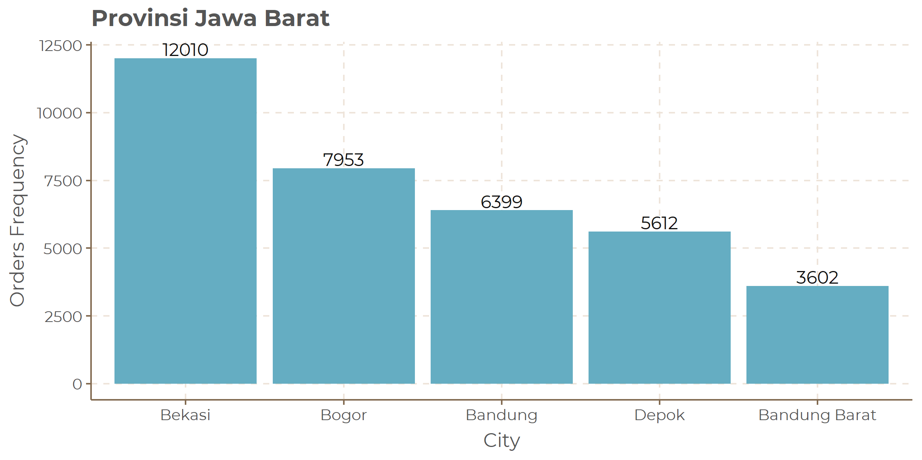
Top 5 City by Top Provinces

Slide 18
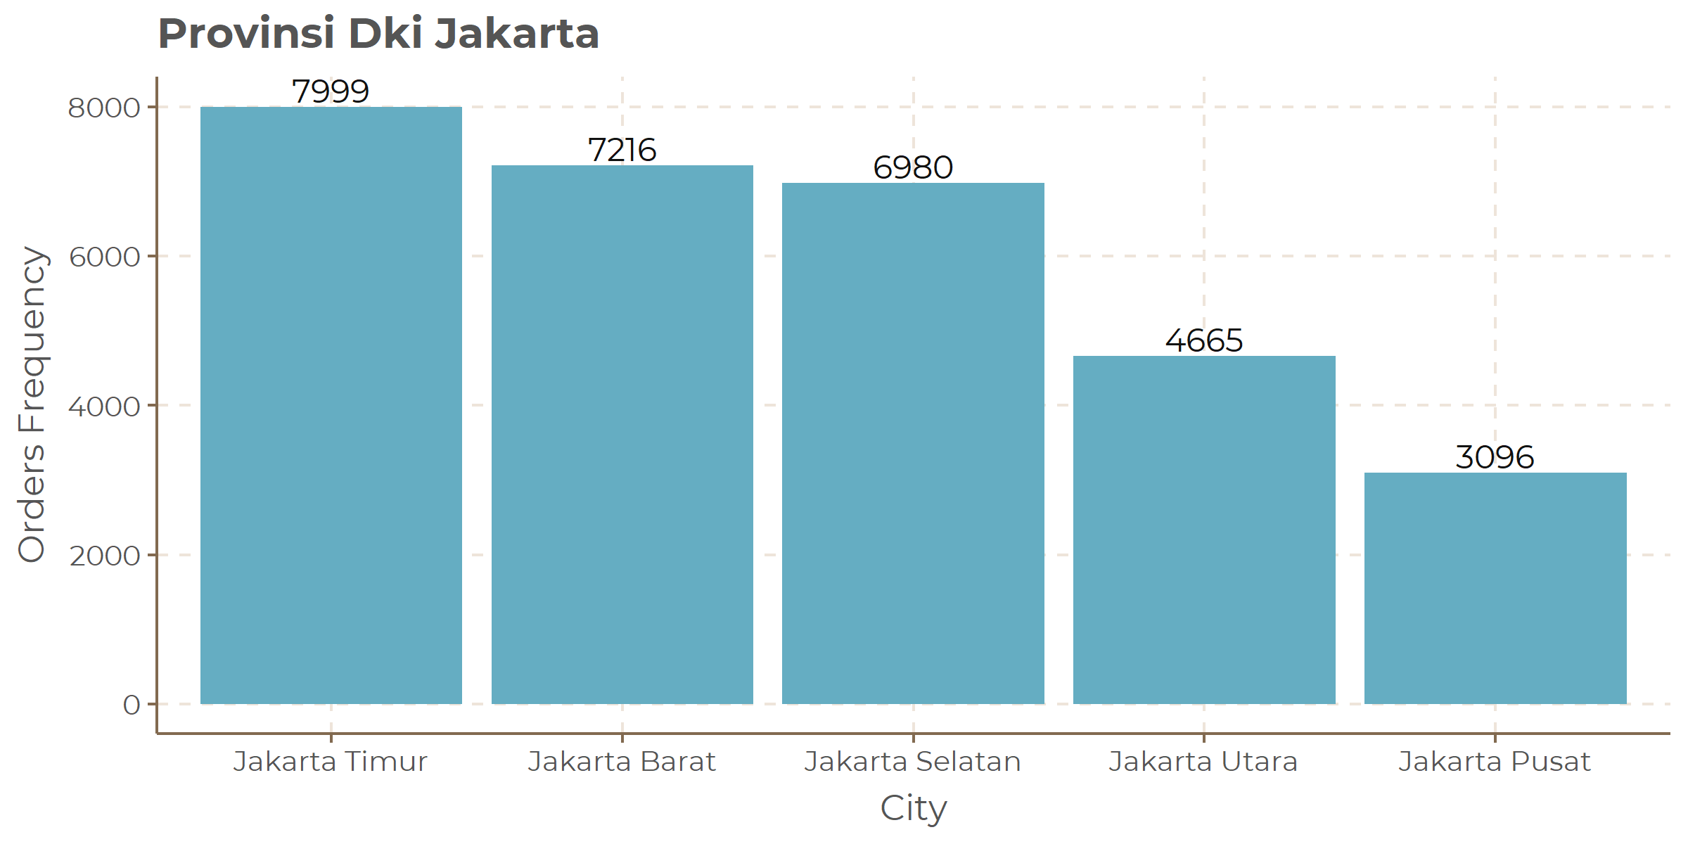
Top 5 City by Second Top Provinces

Slide 19
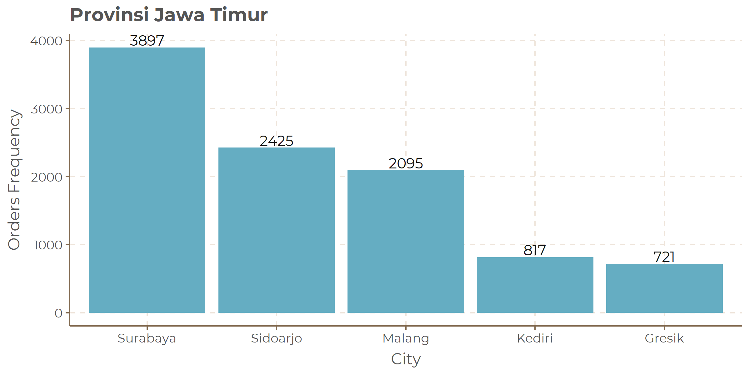
Top 5 City by Third Top Provinces

Slide 20
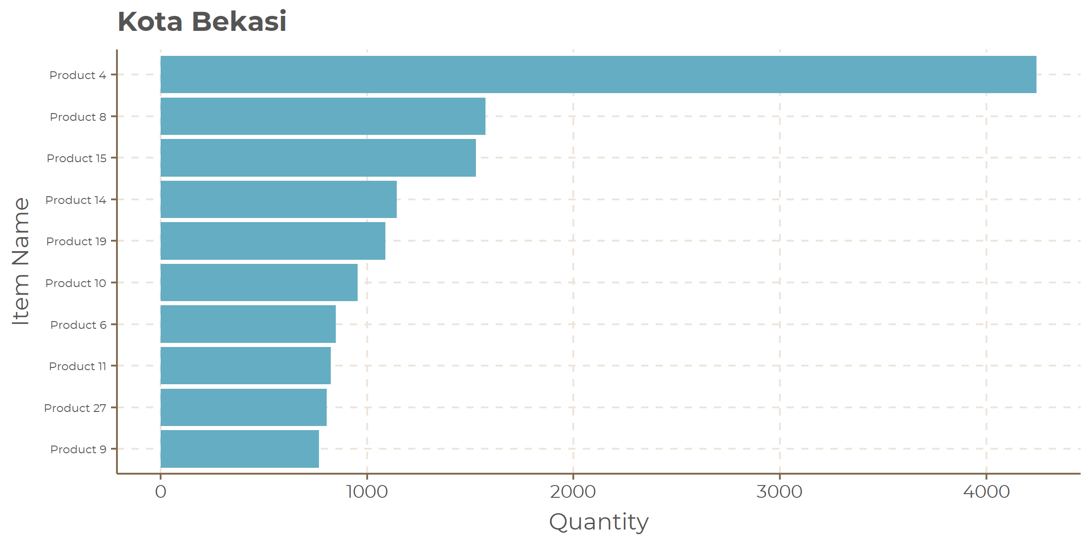
Top 10 Items by Top Cities

Slide 21
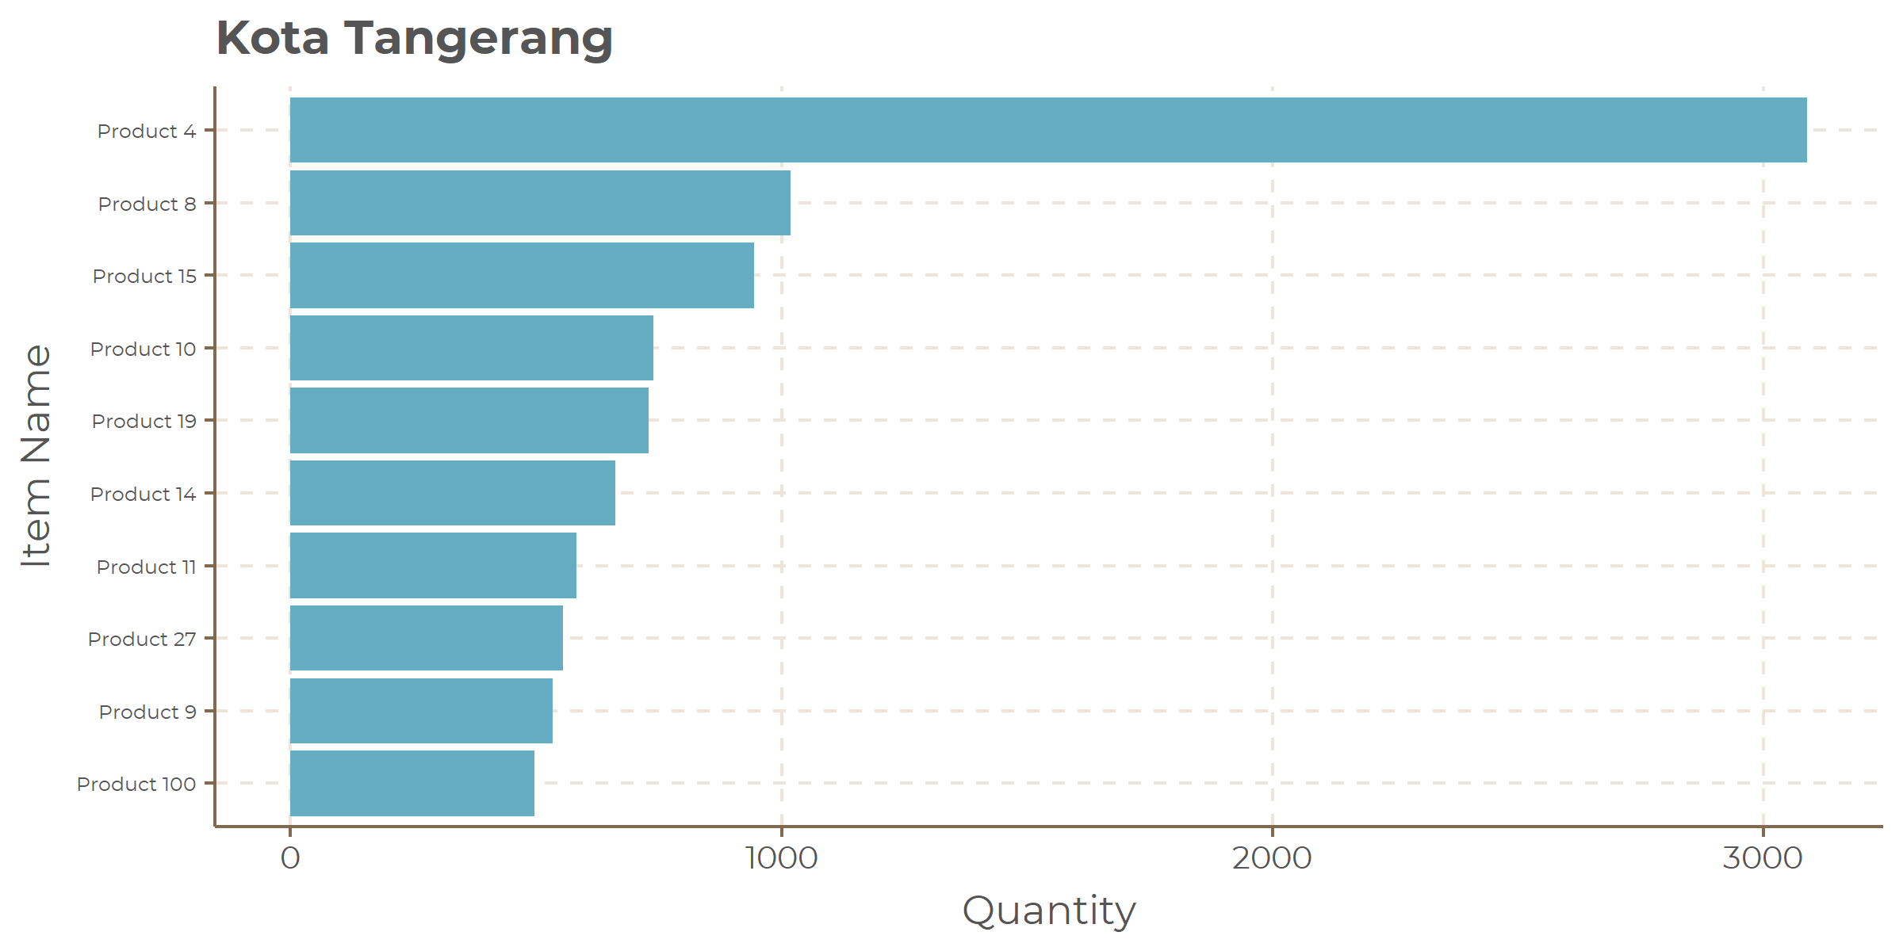
Top 10 Items by Second Top Cities

Slide 22
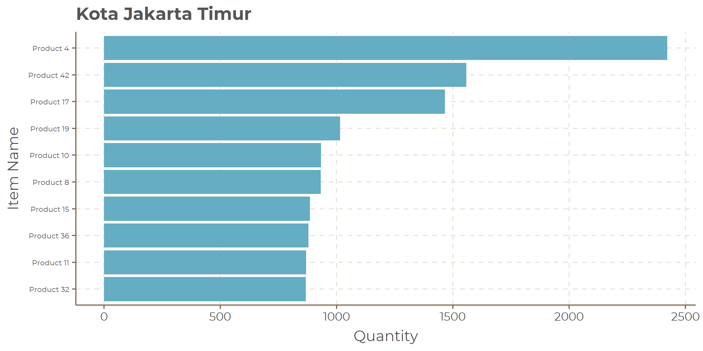
Top 10 Items by Third Top Cities

Slide 23
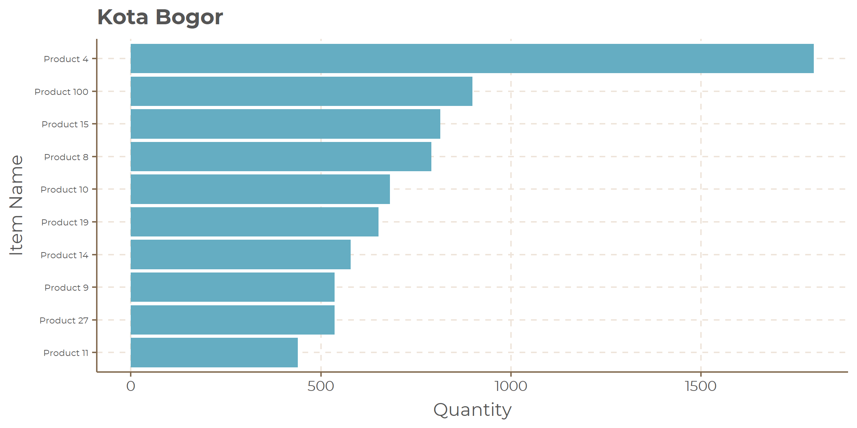
Top 10 Items by Fourth Top Cities

Slide 24
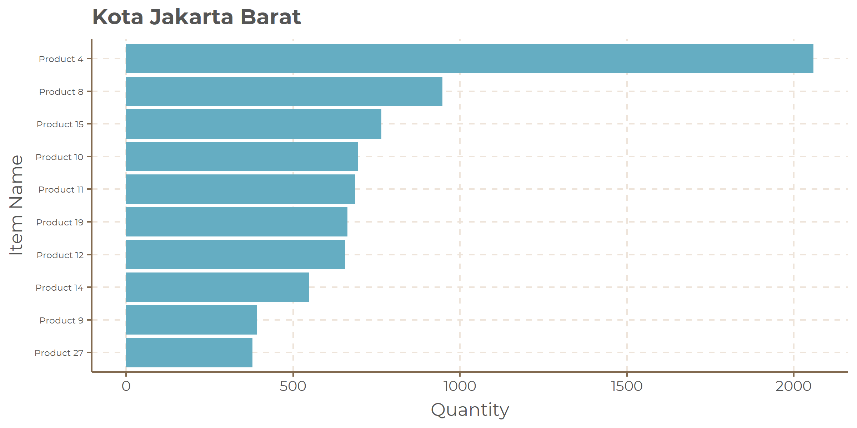
Top 10 Items Fifth by Top Cities

Slide 25
Thank You!

